Slide 1


Titolo presentazione sottotitolo
1
Active Learning for
social media data classification
Milano, XX mese 20XX
Progetto di Ingegneria Informatica – a.a. 2023/24

Slide 2
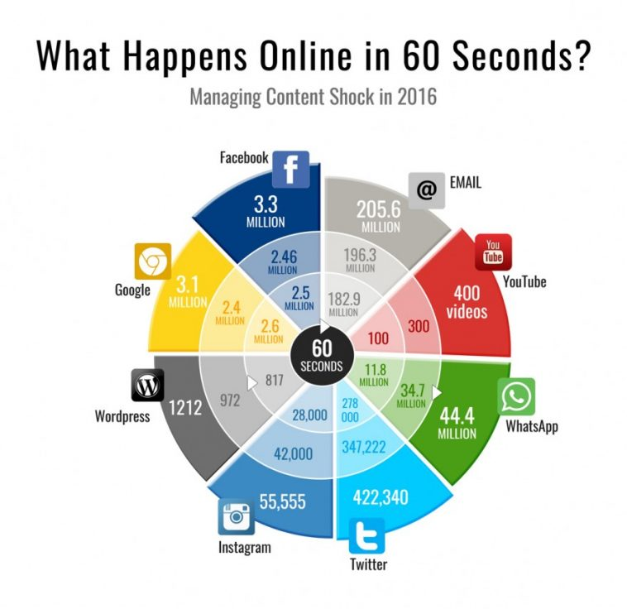


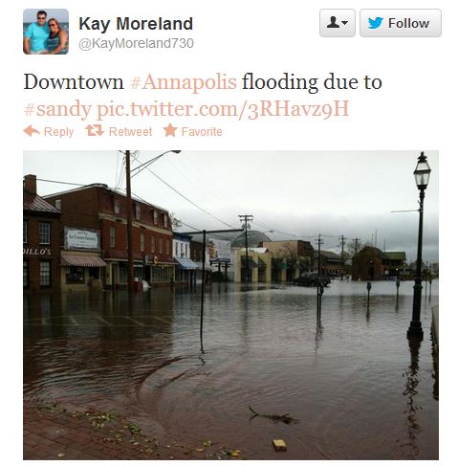


Introduction
2
The problem
The solution
But another problem arises…
There is TOO MUCH content
Natural disasters are increasing in frequency,
and crisis response is essential to limit the damages
Social media has become a fast and easily accessible tool to communicate and receive news
Tommaso Crippa – Progetto di Ingegneria Informatica – a.a. 2023/24

Slide 3
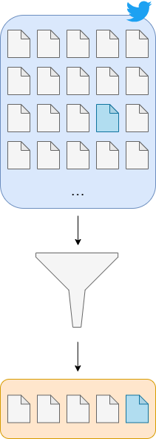
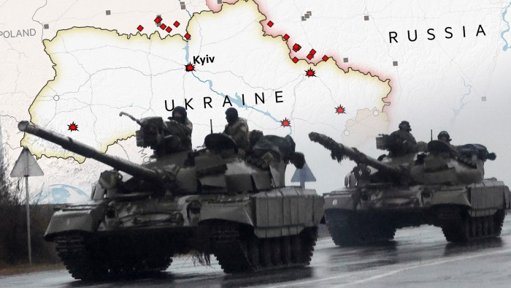
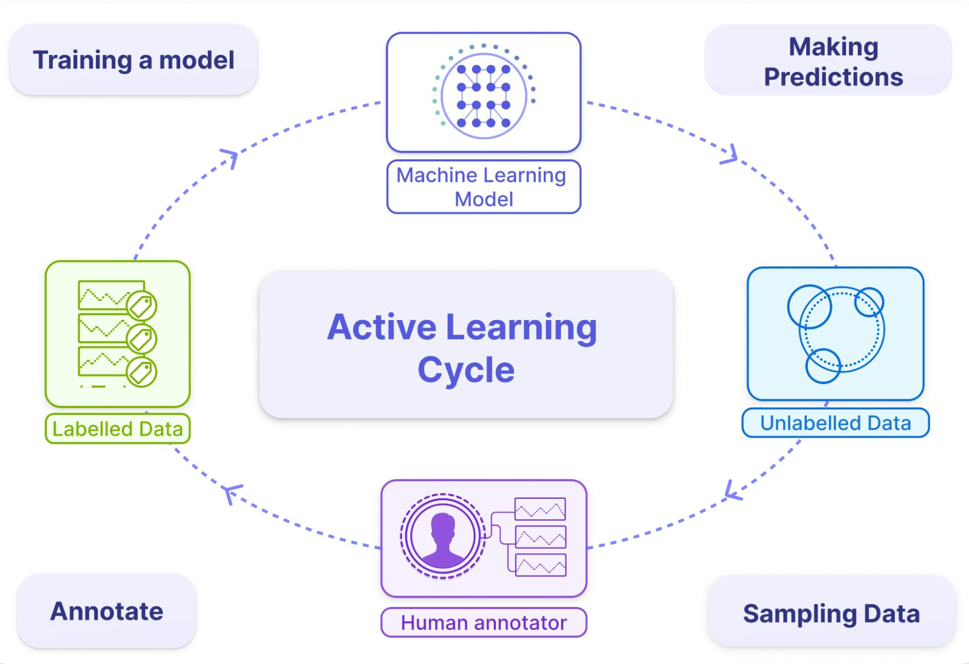
Objective
3
… and how it can be resolved
Objective:
Study the effectiveness of Active Learning
Explore different Active Learning techniques
Examine performance between models
Determine most important parameters
…
Analyzed event:
First weeks of the Russo-Ukranian war (22/02/2022 to 07/03/2022)
Tommaso Crippa – Progetto di Ingegneria Informatica – a.a. 2023/24

Slide 4
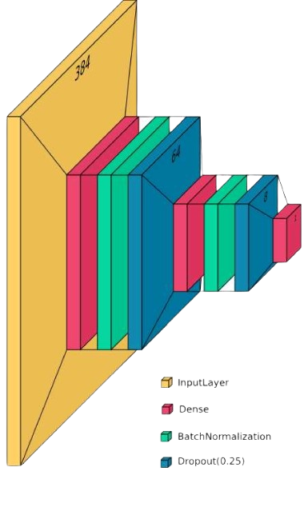
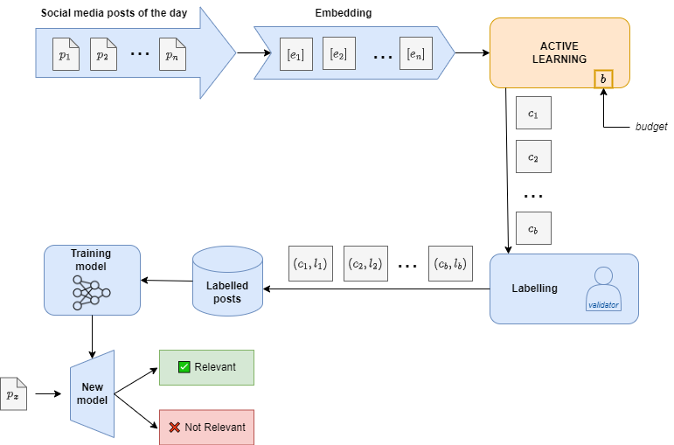
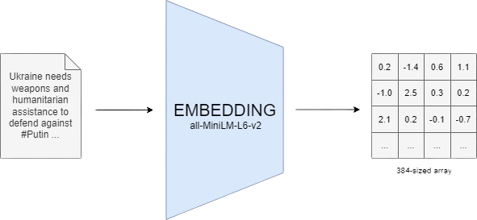
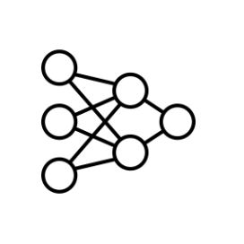


Methodology
4
325.000+ posts
~9% relevant
~23.000 posts/day
Tommaso Crippa – Progetto di Ingegneria Informatica – a.a. 2023/24

Slide 5
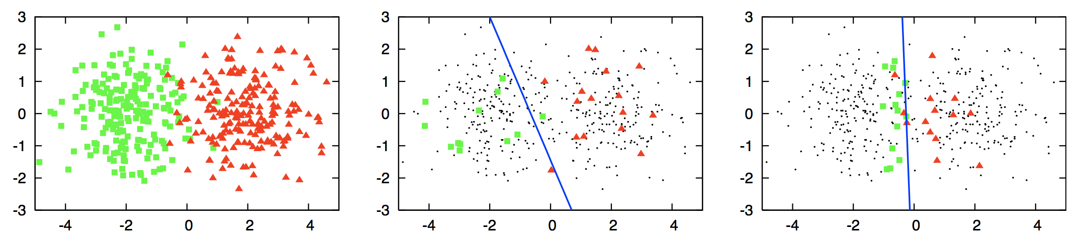
Active Learning
5
random sampling
70% accuracy
original dataset
active learning sampling
90% accuracy
Analyzed
Techniques
Farthest-First Selection
Minimax Selection
Tommaso Crippa – Progetto di Ingegneria Informatica – a.a. 2023/24

Slide 6
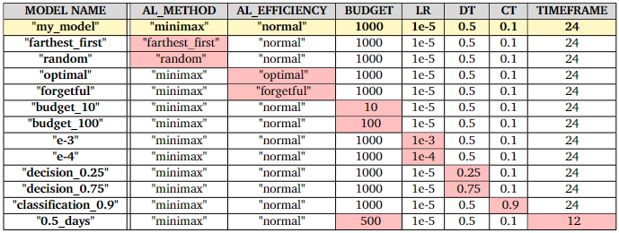
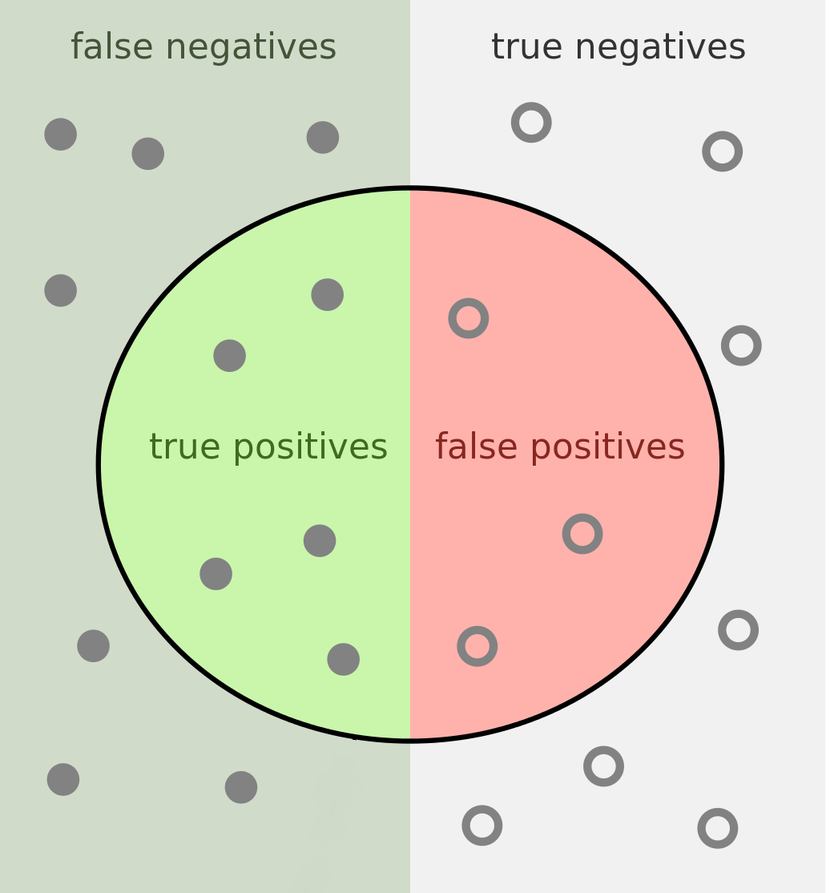
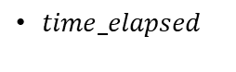
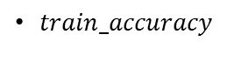

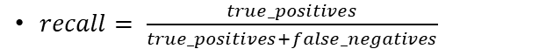

Models and Performance Metrics
6
Models created by manipulating
the following parameters:
AL_METHOD
AL_EFFICIENCY
BUDGET
…
Performance Metrics used to evaluate the models:
$precision= \frac{true_positives}{true_positives+false_positives}$
$train_accuracy$
$recall= \frac{true_positives}{true_positives+false_negatives}$
$time_elapsed$
$f1= \frac{2 ∙precision ∙recall}{precision è recall}$
Tommaso Crippa – Progetto di Ingegneria Informatica – a.a. 2023/24

Slide 7
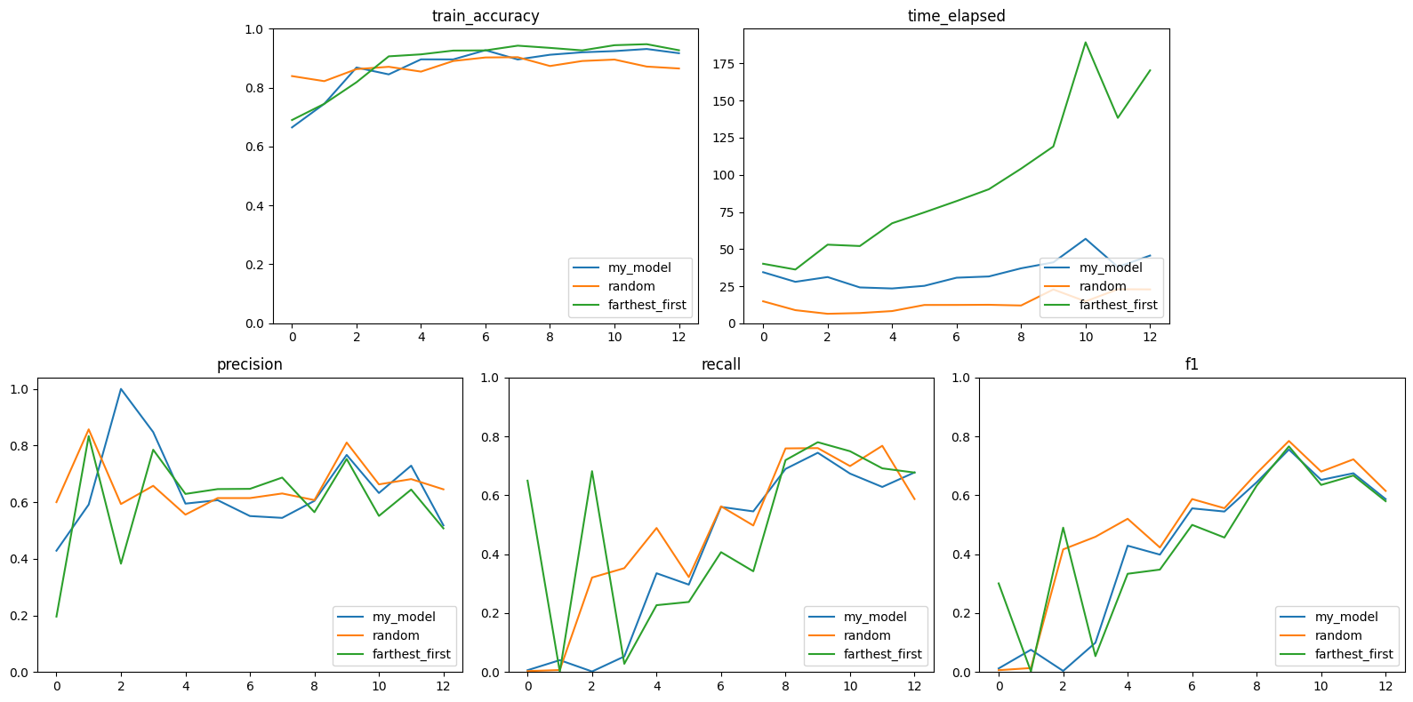
Results – Active Learning Techniques
7
Similar performance between active learning techniques
Farthest-first scales linearly to the number of labels
The active learning algorithms have better train accuracy then random sampling, but have similar results when testing on unseen data
Tommaso Crippa – Progetto di Ingegneria Informatica – a.a. 2023/24

Slide 8
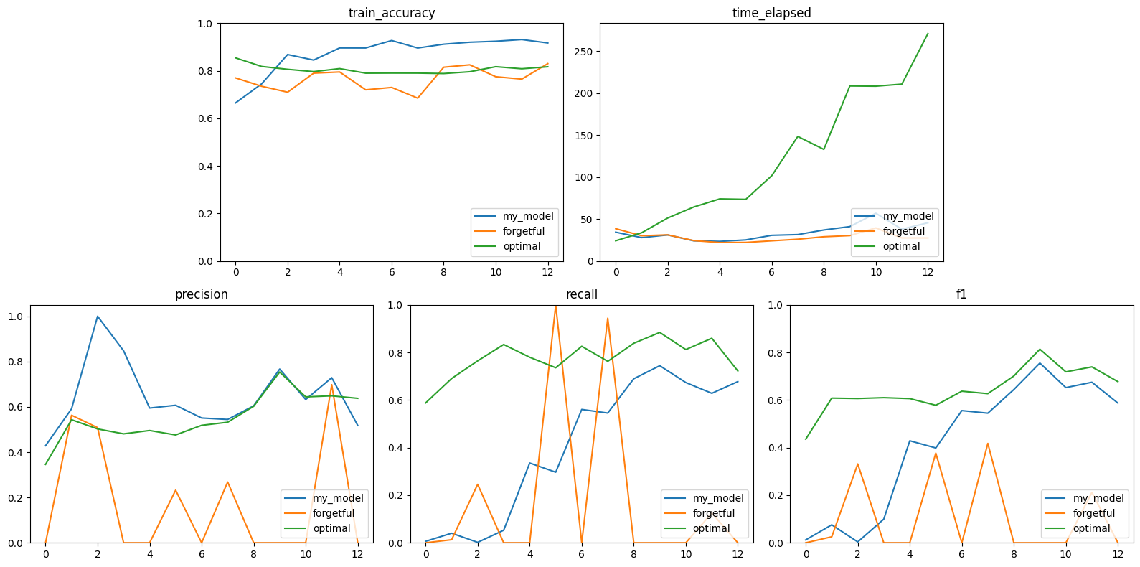
Results – Active Learning Efficiency
8
Forgetful model has inconsistent results, doesn’t have enough data to train properly
Optimal model has similar precision then normal one, but bests it with a higher recall
While the active learning approach yields slightly lower results then the optimal one, it is much less time consuming and less computionally intensive
Tommaso Crippa – Progetto di Ingegneria Informatica – a.a. 2023/24

Slide 9
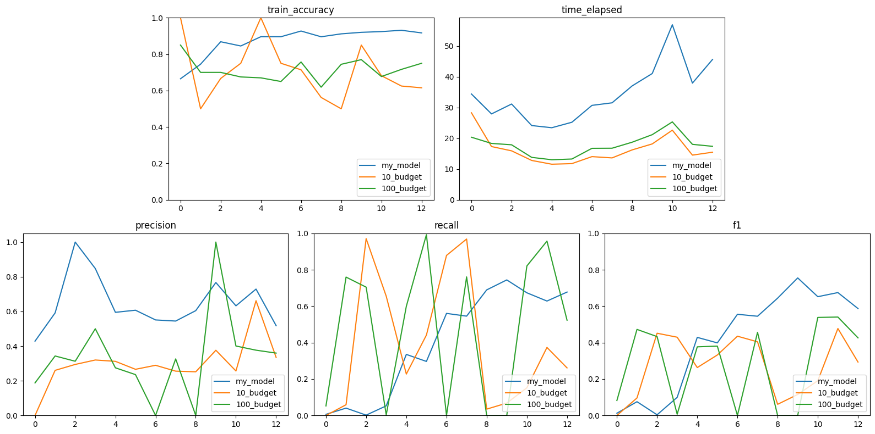
Results – Budget Used
9
Having only 10 labels per timeframe isn’t enough to create a coherent model
The model’s performance scale proportionally to the labelling budget
There is an crucial tradeoff during the selection of the budget, as a higher budget will lead to better performance but also higher computation times
Tommaso Crippa – Progetto di Ingegneria Informatica – a.a. 2023/24

Slide 10

Conclusions
10
Active Learning techniques had better results then random sampling with training data, but were similar with unseen data
With just a small batch of data, the active learning models slowly approached similar results to the optimal ones
The selection of the models’ parameters, such as the budget, is a crucial part of the development of the model infrastructure
In conclusion Active Learning has proven to be a great tool to collect and classify social media data during dynamic events
Tommaso Crippa – Progetto di Ingegneria Informatica – a.a. 2023/24

Slide 11
Titolo presentazione sottotitolo
11
Thank you for your attention
Milano, XX mese 20XX
Tommaso Crippa – Progetto di Ingegneria Informatica – a.a. 2023/24

